Slide 1
Hamilton Finance and Advisory Committee
Commentary and Recommendations on the Warrant for:
ANNUAL TOWN MEETING
Saturday April 5, 2025
ARTICLE 2025/4 2-11 – HWRSD Consolidated Elementary School

Slide 2
School Investments – A Look Back…and Forward
In the 1950’s and 60’s …
The “Greatest Generation”….
….responded to the post-WWII demand for school capacity in Hamilton & Wenham… and embarked on a building campaign….
…from which the Cutler,
Buker,
Winthrop &
High schools emerged.
$ | Greatest Generation | Baby Boomers | Gen X, Millennials, Gen Z
School | 1950 – 1974 (25 Years) | 1975 – 1999 (25 Years) | 2000 – 2024 (25 Years) | 2025 – 2049 (25 Years) | 2050 –>
Cutler | Constructed – ‘51 Additions – ‘52, ‘56 | Addition – ‘92 | X | Combined Elementary School →740 Students 127,298 sq ft 172 sq ft per student $ 142M – Gross Cost $193k gross per student $124k net per student $ 49M – MSBA $61M - Hamilton
Winthrop | Constructed – ’59 Additions – ‘66 | X | X
Winthrop | Constructed – ’59 Additions – ‘66 | X | X
Buker | Constructed – ‘53 Additions – ‘55 | Addition – ‘89 | X
Buker | Constructed – ‘53 Additions – ‘55 | Addition – ‘89 | X | Investment Required
High School | Constructed – ‘61 | Renovation / Addition – ‘99 | X
Miles River | - | Constructed – ‘99 | X
23 yrs
26 yrs

Slide 3
Some things to consider
As far back as 2014, a consolidated school was being discussed by both towns and the District.
Consolidating two schools removes two old buildings from the capital repair/improvement pipeline.
The immediate availability of the $49M MSBA reimbursement award.
Alternatives to the proposed school project will cost the School District more in the long-run.
School construction costs have increased dramatically (30 – 50%) since 2020.
It is expected this upward trajectory will continue. Industry forecasts predict a 5-7% increase in overall construction costs in 2025.

Slide 4
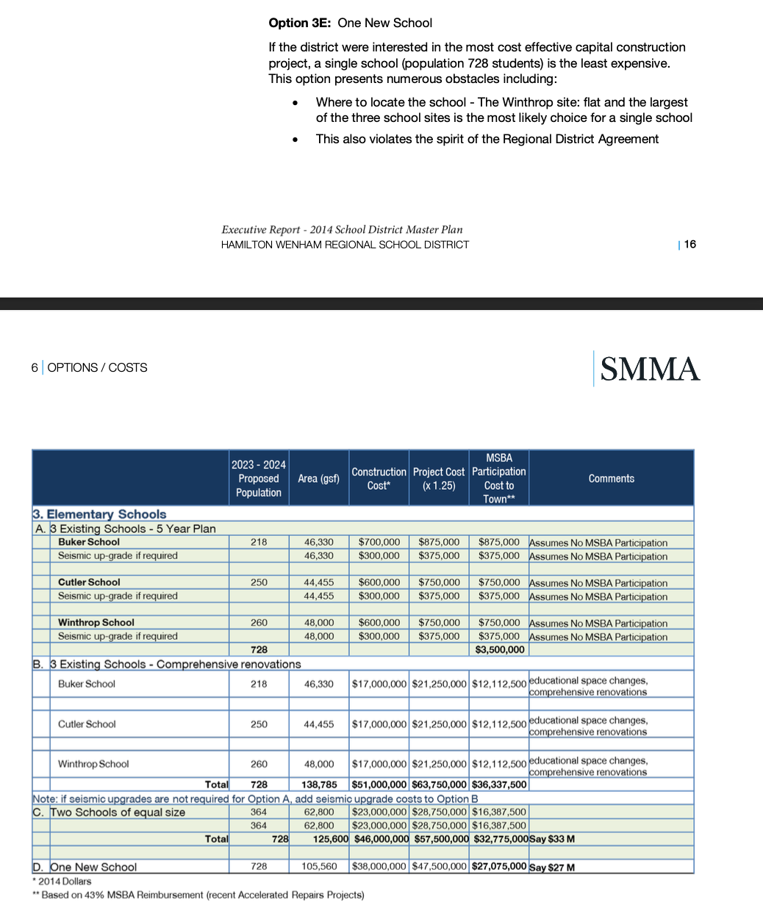
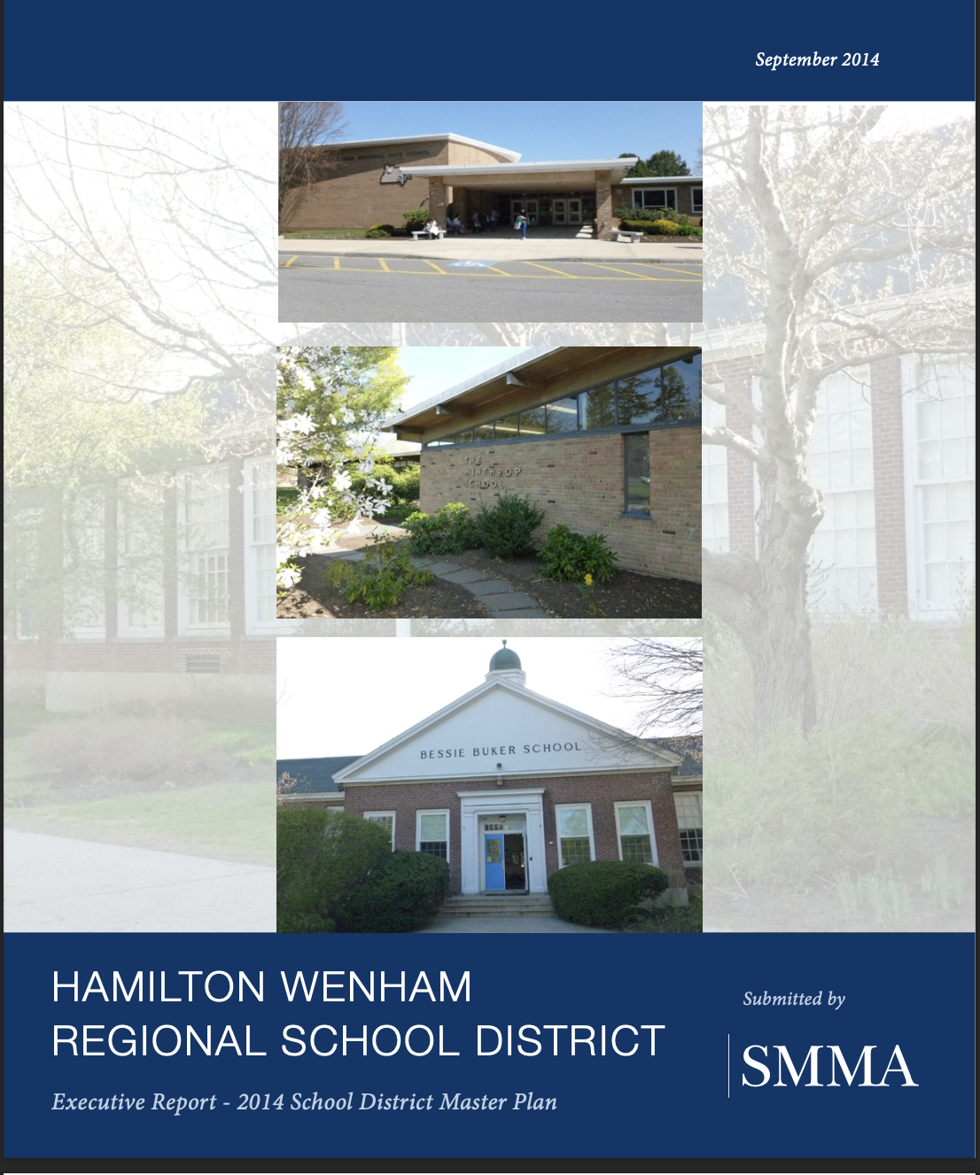
2014 HWRSD Master Plan
If the district were interested in the most cost effective construction project, a single school (population 728 students) is the least expensive

Slide 5
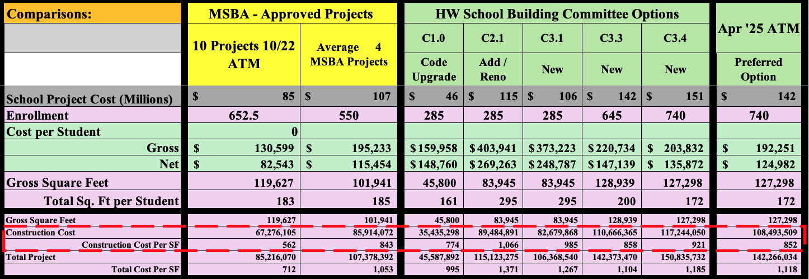
New School – Unit Costs - Comparisons
All amounts listed are estimates
Vote
Economies of Scale

Slide 6
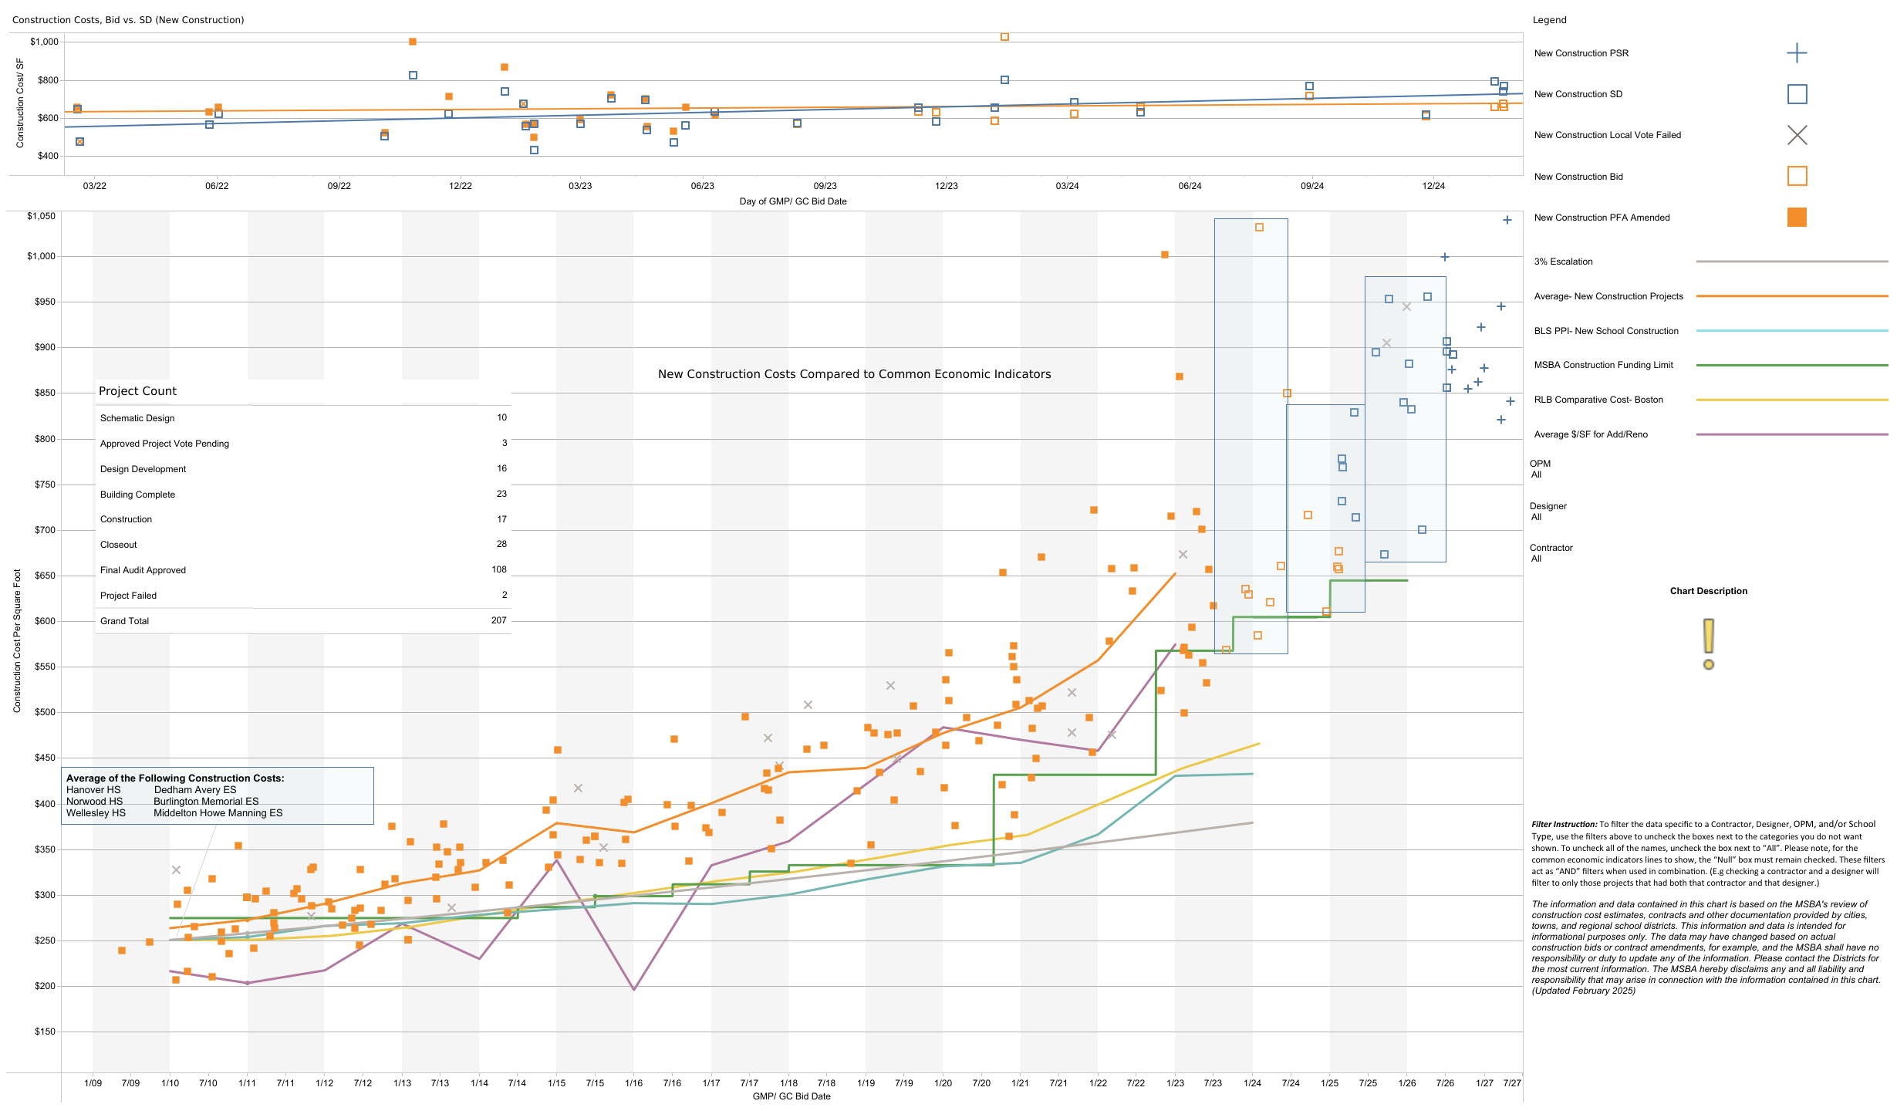
School “New” Construction Costs
ATM - New School Warrant – MSBA “New” Construction Cost
$1,000 /sq. ft.
$800 / sq. ft.
$750 / sq. ft.
File created on: 3/16/2025 – Source: MSBA Website
$600 / sq. ft.
Bid Close
Jan ‘26 – Jul ‘27

Slide 7
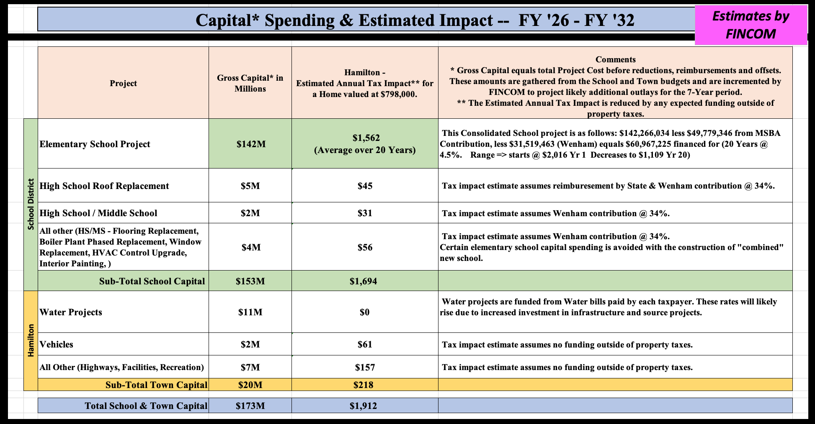

Slide 8
One New School vs. Two New Schools – PDP Costs
The building cost data used for this analysis was based on the 12/20/23 “Revision 1” Version of the “PDP Cost Comparative Analysis” supplied by JCJ Architecture..
Option #1: One School:
New Consolidated Cutler and Winthrop Elementary School
Students: 740 Students
Square footage 127,298
Per Student 172
Cost
Total* $ 142M
Construction $ 108M Per Sq Ft $852
Non-Construction $ 34M
Per Student (Gross) $192 thous.
* Total Cost is 129% of Construction Cost
Option #2: Two Schools:
Construct: New Cutler School in 2028 - 285 Students
Construct: New Winthrop School in 2038 - 430 Students
Students: - 715 Students
Square footage 178,247
Per Student 249
Cost
Total* $ 228M
Construction $ 178M Per Sq Ft $1,001
Non-Construction $ 50M
Per Student $319 thous.
* Total Cost is 128% of Construction Cost
Difference
$86M

Slide 9
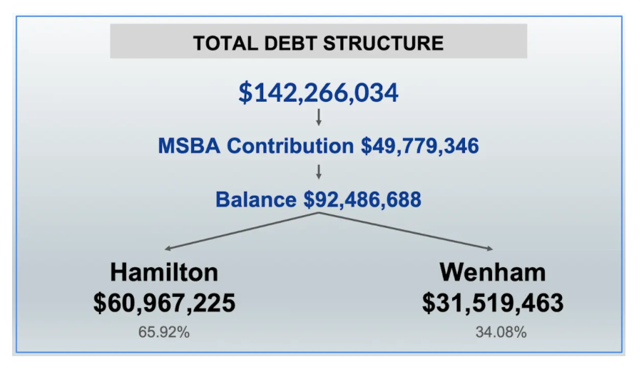
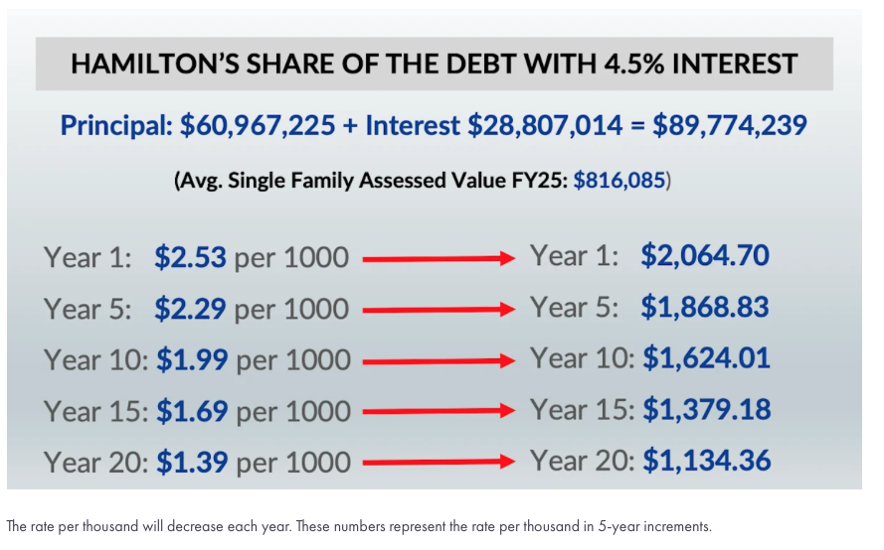
Tax Impact of Proposed School

Slide 10
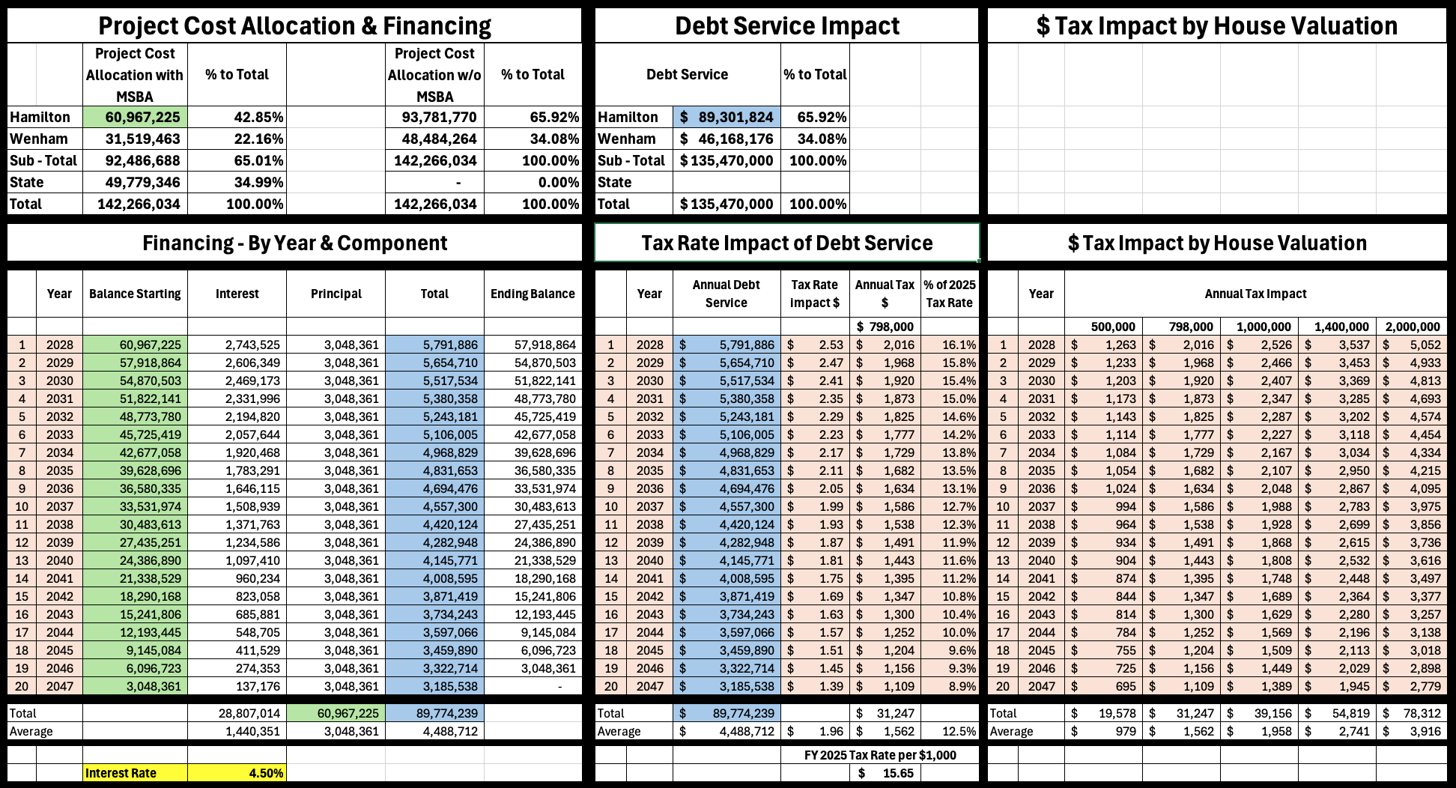
Tax Impact of Proposed School

